Slide 1
“Tell me and I will forget, show me and I may remember; involve me and I will understand.” (Confucius)

Slide 2
The Chair Game
Remain seated on your side of the room during the entire time of the activity
You can only use the chairs available (you cannot use any extra chairs or sit on a table or on the floor)

Slide 3
Christopher Columbus discovers America

Slide 4
Ferdinand Magellan sails around the globe

Slide 5
Francisco Pizzaro defeats the Incas

Slide 6
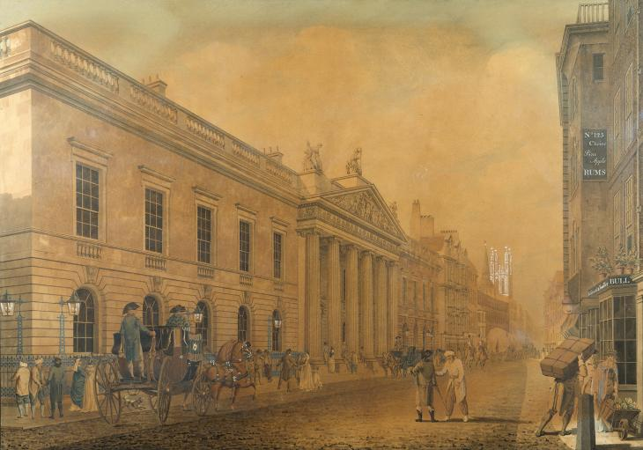
East India Company – the first imperial trading company – is established (1600)

Slide 7
Transatlantic slave trade begins

Slide 8
Sugar cane is brought to Cuba

Slide 9
Coffee is started being cultivated in Brazil

Slide 10
Deposits of gold are discovered in the South African Republic

Slide 11
The World Bank is established

Slide 12
The first super tank sets sail

Slide 13
The first microchip is made

Slide 14
In agriculture, the „green“ revolution takes place

Slide 15
The World Trade Organization is established

Slide 16
The number of computers surpasses one billion

Slide 17
The number of people surpasses 7 billion

Slide 18
How do you feel?

Slide 19
What was happening during the game?

Slide 20
Who do you think each group represents?

Slide 21
What do you think the photos represent?

Slide 22
What do the chairs represent?

Slide 23
“When the last tree is cut down, the last fish eaten, and the last stream poisoned, you will realize that you cannot eat money.” (Cree Indian prophecy)

